Slide 1
Agenda
Compare the Two Approaches for training an environment dynamics model in Model-Based RL (MBRL)
Utilizing Ensemble Networks for World Models
Utilizing Latent Representations and RNN-like Architecture for World Models
Discuss samples needed for effective policy
Questions:
With little direct comparison of the two MBRL approaches, which should be our initial choice to model the network dynamics to train an effective policy?
Should we use an encoder for our observations? Or train directly in the observation space?

Slide 2
how many samples are required for convergence?
In MBRL two approaches exist contemporary literature:
Ensemble Dynamics Model
Trains 7 NN models trained to predict the next state & reward given current state and action
Latent-variable World Model
Combination of variational autoencoders and RNNs to learn a latent dynamics model able to predict future latent states
Both methods boast increased sample efficiency.
Generally, though dependent on environments considered, MRBL methods seem to show effective learning from 10,000 samples to > 2 million samples

Slide 3
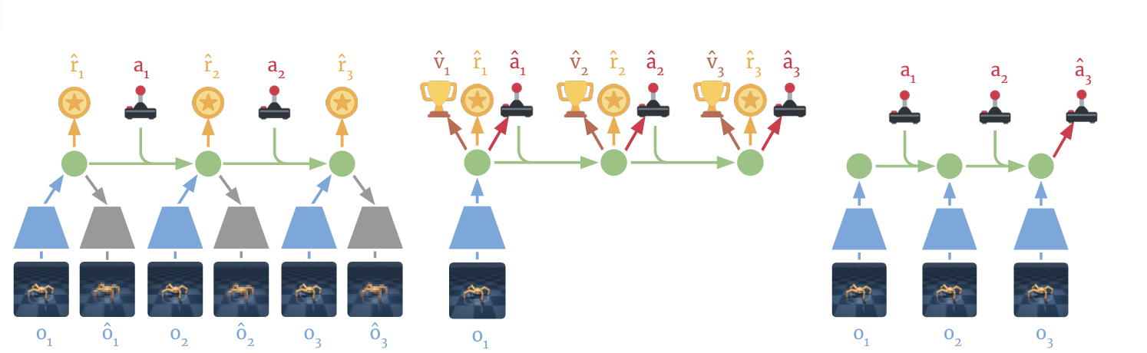
Latent Dynamics Model
Variational Autoencoder for computing latent states
Imagine trajectories and train policy using actor critic algorithm
Interact with environment using policy and gain more experiences
RNN-like architecture that can predict future states

Slide 4
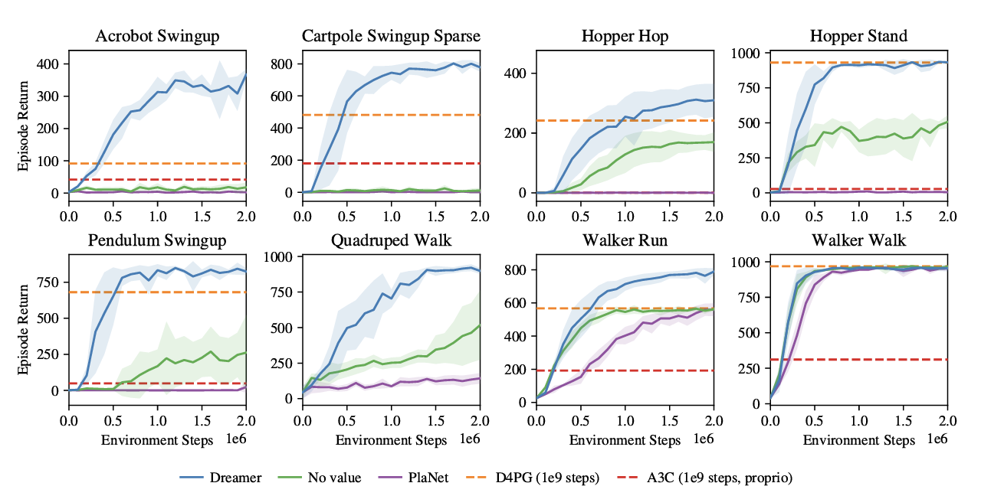
Dreamer – using latent-variable world model
Seminal paper that introduced a single MBRL agent that generalized across different tasks with encoding past experience into latent states – effectively learns at ~500,00 environment steps

Slide 5
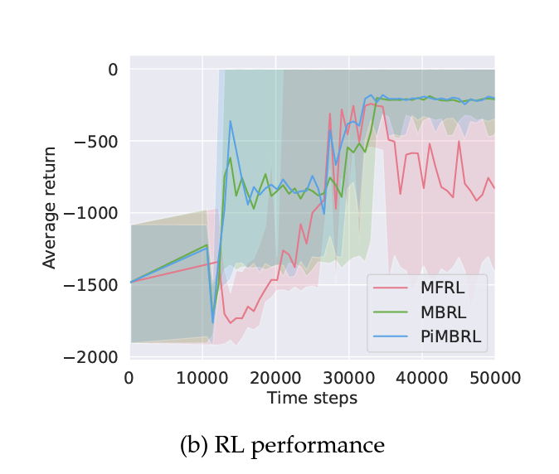
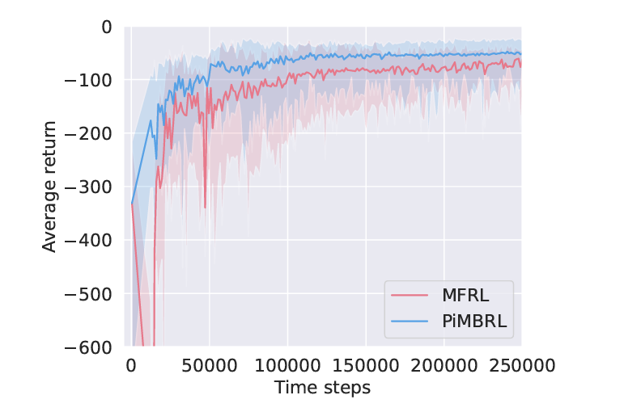
Physics-Informed Dyna-Style MBRL
Dyna-style MBRL for dynamic control environments. Number of steps to converge are ~5,000 training time steps for simple tasks and need up to 50,000 time steps for much more complex tasks
Pendulum
Much more complex tasks

Slide 6
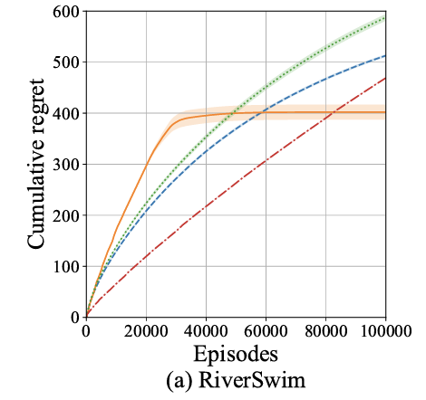

FiniteBOO
Model-based algorithm (FiniteBOO) that incorporates Optimism in the face of uncertainty (OFU) and required ~30,000 episodes to converge in simpler environments

Slide 7
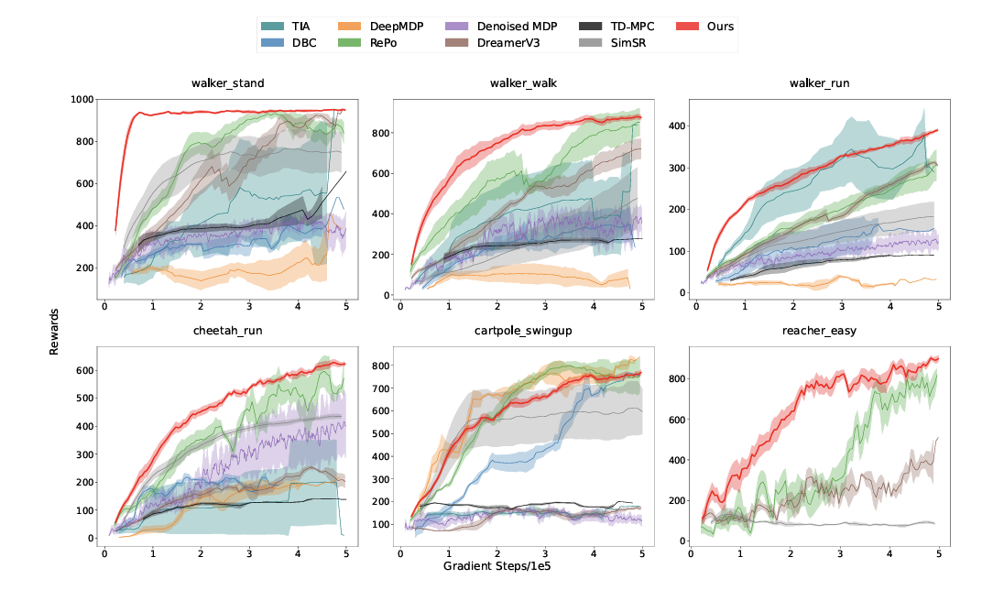
Learning Latent Dynamics from World Models using Hybrid RSSM
Proposes an improved state-space model (similar to RSSM in dreamer) and requires ~100,000 steps to effectively lean in a variety of environments

Slide 8
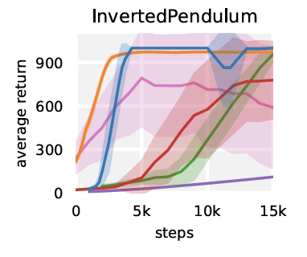
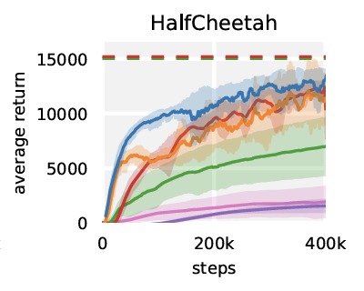
MBPO: Sample-efficiency without latent encoding – using Ensemble networks
MBPO ensemble learning can learn in < 5000 steps in simple environments and up to ~100,000 training steps in more difficult tasks

Slide 9
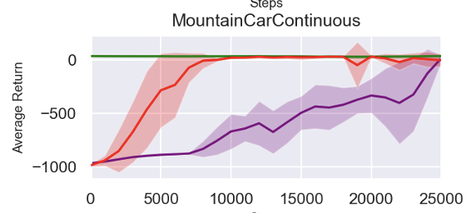

SINDy Algorithm – compares itself to MBPO
Cites MBPO as ~5,000 to 10,000 training steps to learn

Slide 10
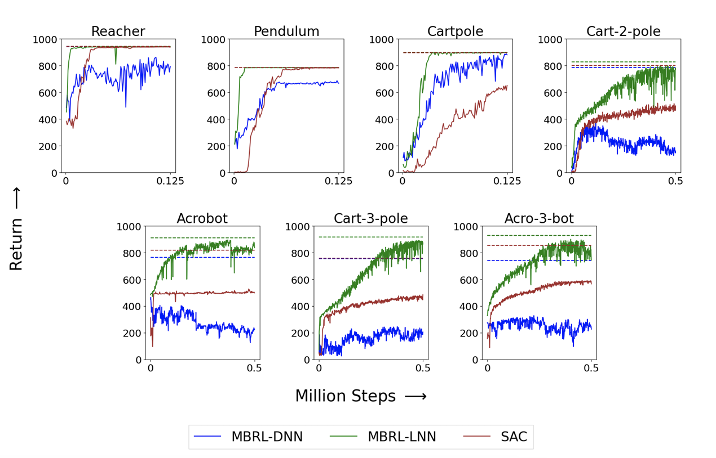
MBRL (Physics-Informed) Sample Efficiency in Robotic Tasks
This approach models the world using Physics-informed NN to learn dynamics without encoding and samples range from ~100,000 steps to 1M steps in robotic control environments

Slide 11
Ensemble Networks vs Variational Auto-encoders for capturing environment dynamics
It is unclear which method would be more sample-efficient for our use case. No literature directly compares the two approaches and their sample efficiency.

Slide 12
“Vanilla” MBRL
Vanilla, or traditional, methods use simple feed-forward NN to learn environment dynamics.
There doesn’t exist much contemporary literature using vanilla MBRL – generally shifted towards using latent-variable world models and ensemble networks.
However, There is an interest in revisiting traditional methods as ensemble approaches are difficult to calibrate, primarily for robotic control tasks – using a single feedforward neural network to models the dynamics of the robotic arm playing ping pong for effective sample efficiency, but this field of study is not mature.

Slide 13
References
https://arxiv.org/pdf/2108.00128
https://arxiv.org/pdf/1906.08253
https://arxiv.org/pdf/2208.14501
https://proceedings.neurips.cc/paper_files/paper/2022/file/5bcb807ae43ad0851a6ba6162a866404-Paper-Conference.pdf
https://arxiv.org/pdf/2212.02179
https://arxiv.org/pdf/2405.06263

Slide 14
~
Ensemble Networks Implementation
Understand first then apply o

